Slide 1


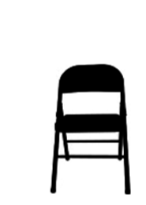
 | Interlake Sporting Association North Pistol, B Stage: Was it 8 or 9? Course Designer: Lars Liden & Marcel Englmaier
SCENARIO: While trying to get a well needed lunch, a 211 is in progress and the violent bank robbers interrupt your lunch with gunfire. Protect the citizenry and do what must be done.
START POSITION: Sitting on chair, feet flat on the ground, facing squarely up range, hands on knees. Handgun loaded and holstered. PCC same position as handgun. Rifle on table with trigger guard over tape, muzzle facing squarely downrange. |  | STRINGS: 1 SCORING: Unlimited SCORED HITS: Best 3 ROUND COUNT: 18 TARGETS: 6 IDPA, 2 NT START-STOP: Audible - Last shot CONCEALMENT: Required Muzzle Safe Points: Muzzle safe markers / 180 degree rule SO NOTES:
STAGE PROCEDURE: At signal, stand up then draw. Engage targets from available cover with at least 3 shots each.
P2
P1

